Slide 1
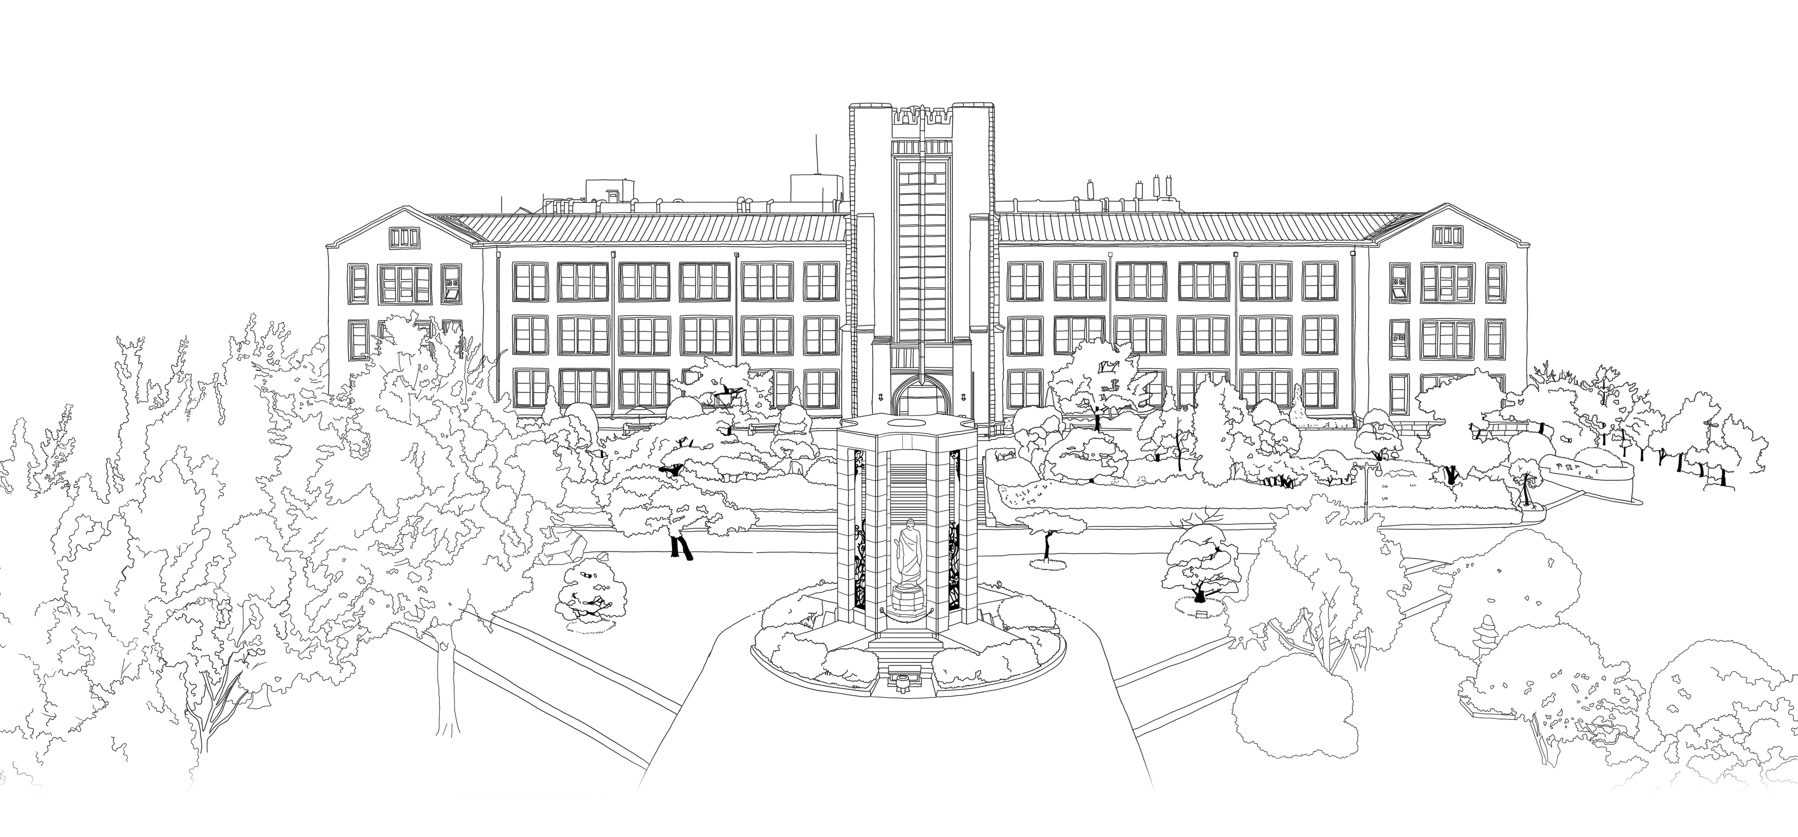


Introduction to Algorithms
DongYeon Kim
Department of Multimedia Engineering
Dongguk University

Slide 2
Contents
Chapter.1 Foundations
The Role of Algorithms in Computing
Algorithms
Algorithms as a technology
Getting Started
Insertion sort
Analyzing algorithms
Designing algorithms
Growth of Functions
Asymptotic notation
Standard notations and common functions
Divide-and-Conquer
The maximum-subarray problem
Strassen’s algorithm for matrix multiplication
The substitution method for solving recurrences
The recursion-tree method for solving recurrences
The master method for solving recurrences
Proof of the master theorem
Probabilistic Analysis and Randomized Algorithms
The hiring problem
Indicator random variables
Randomized algorithms
Probabilistic analysis and further uses of indicator random variables
Notes:
모든 Feature마다 이상치를 제거하게 되면 너무 많은 데이터 손실이 발생

Slide 3
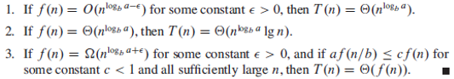
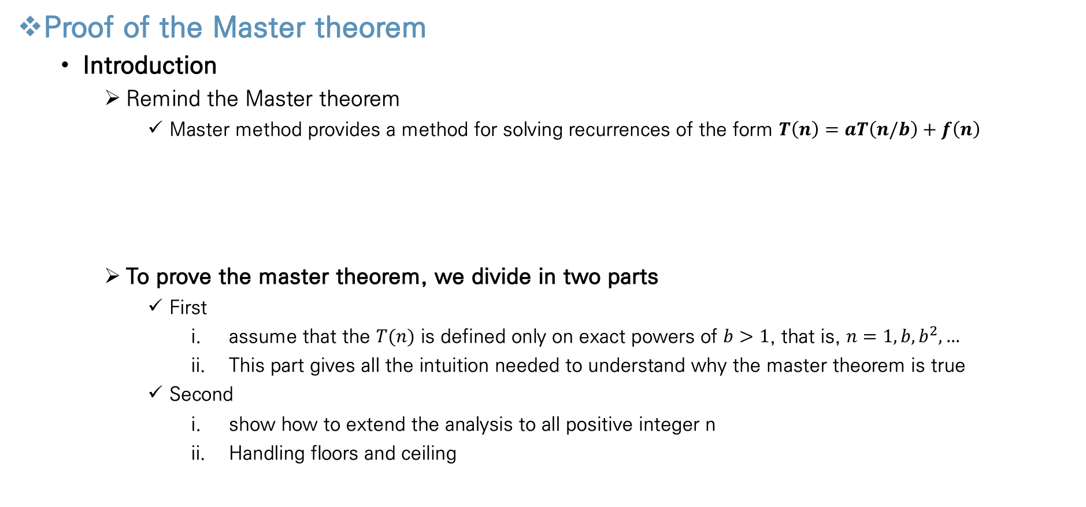
Divide-and-Conquer
Proof of the Master theorem
Introduction
Remind the Master theorem
Master method provides a method for solving recurrences of the form $T\left(n\right)=aT\left(n/b\right)+f\left(n\right)$
To prove the master theorem, we divide in two parts
First
assume that the $T(n)$ is defined only on exact powers of $b>1$, that is, $n=1,b,b^{2},…$
This part gives all the intuition needed to understand why the master theorem is true
Second
show how to extend the analysis to all positive integer n
Handling floors and ceiling
Notes:
모든 Feature마다 이상치를 제거하게 되면 너무 많은 데이터 손실이 발생

Slide 4
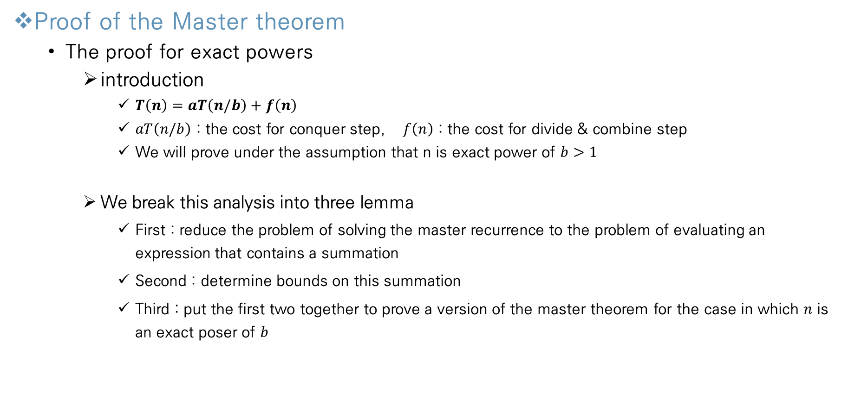
Divide-and-Conquer
Proof of the Master theorem
The proof for exact powers
introduction
$T\left(n\right)=aT\left(n/b\right)+f\left(n\right)$
$aT\left(n/b\right)$ : the cost for conquer step, $f\left(n\right)$ : the cost for divide & combine step
We will prove under the assumption that n is exact power of $b>1$
We break this analysis into three lemma
First : reduce the problem of solving the master recurrence to the problem of evaluating an expression that contains a summation
Second : determine bounds on this summation
Third : put the first two together to prove a version of the master theorem for the case in which $n$ is an exact poser of $b$
Notes:
모든 Feature마다 이상치를 제거하게 되면 너무 많은 데이터 손실이 발생

Slide 5
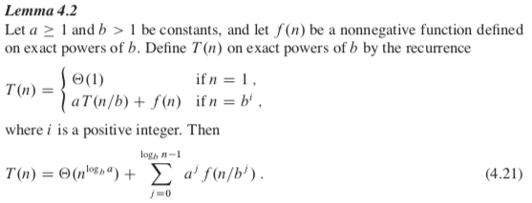
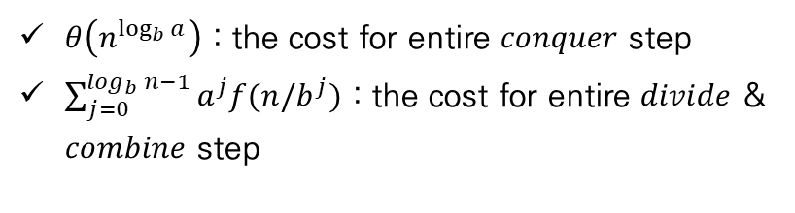
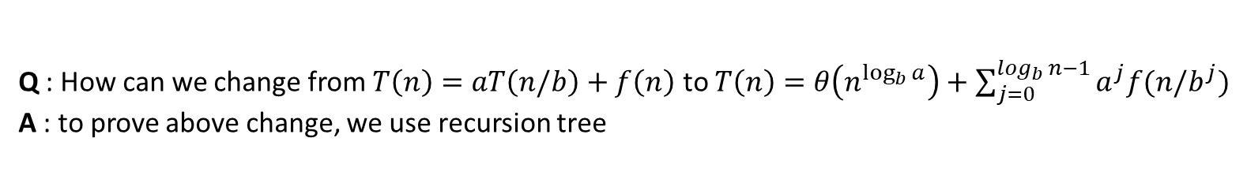
Divide-and-Conquer
Proof of the Master theorem
The proof for exact powers
Step 1 - reduces the problem from master recurrence to the problem contains summation
$θ\left(n^{\log_{b}{a}}\right)$ : the cost for entire $conquer$ step
$\sum_{j=0}^{\log_{b}{n}−1}{a^{j}f(n/b^{j})}$ : the cost for entire $divide$ & $combine$ step
Q : How can we change from $T\left(n\right)=aT\left(n/b\right)+f\left(n\right)$ to $T\left(n\right)=θ\left(n^{\log_{b}{a}}\right)+\sum_{j=0}^{\log_{b}{n}−1}{a^{j}f(n/b^{j})}$
A : to prove above change, we use recursion tree
Notes:
모든 Feature마다 이상치를 제거하게 되면 너무 많은 데이터 손실이 발생

Slide 6
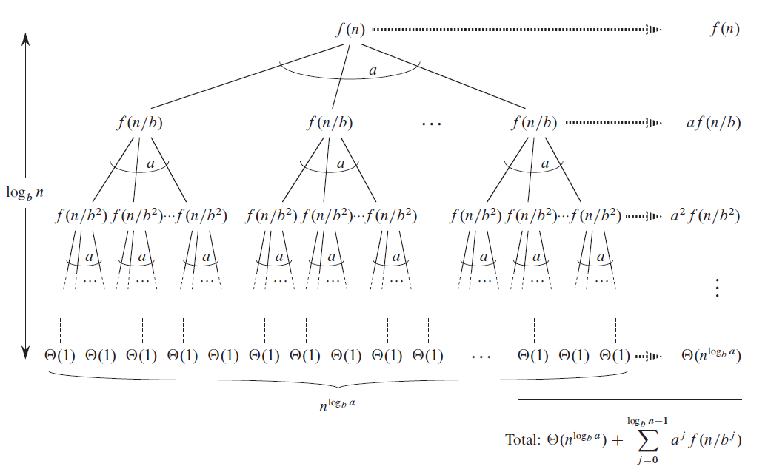

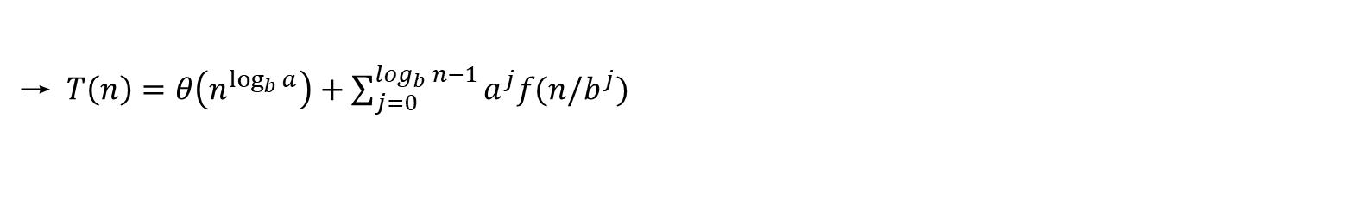
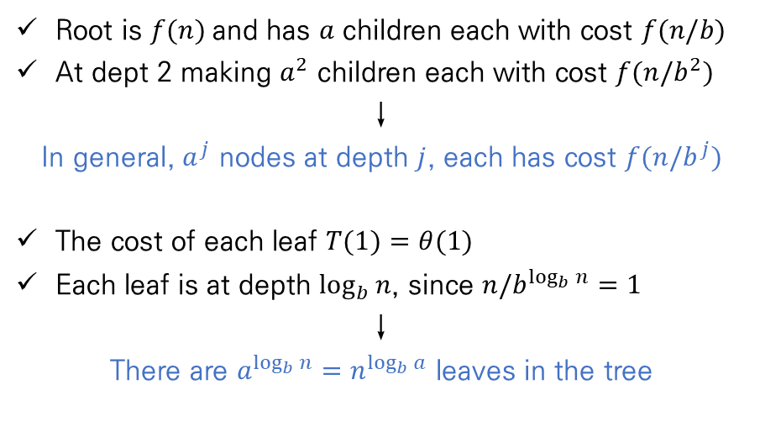
Divide-and-Conquer
Proof of the Master theorem
The proof for exact powers
Step 1 - reduces the problem from master recurrence to the problem contains summation
Root is $f(n)$and has $a$ children each with cost $f(n/b)$
At dept 2 making $a^{2}$ children each with cost $f(n/b^{2})$
↓
In general, $a^{j}$ nodes at depth $j$, each has cost $f(n/b^{j})$
The cost of each leaf $T(1)=θ(1)$
Each leaf is at depth $\log_{b}{n}$, since $n/b^{\log_{b}{n}}{=1}$
↓
There are $a^{\log_{b}{n}}=n^{\log_{b}{a}}$ leaves in the tree
→ $T\left(n\right)=θ\left(n^{\log_{b}{a}}\right)+\sum_{j=0}^{\log_{b}{n}−1}{a^{j}f(n/b^{j})}$
conquer step cost for $n^{\log_{b}{a}}$ leaves
divide & combine step cost for every depth except for bottom
Notes:
N over b

Slide 7
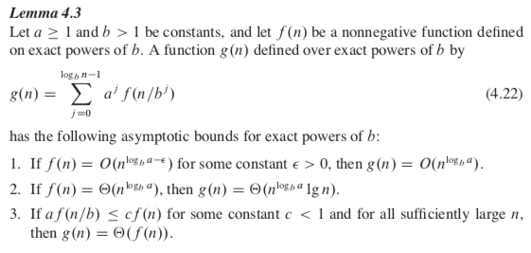
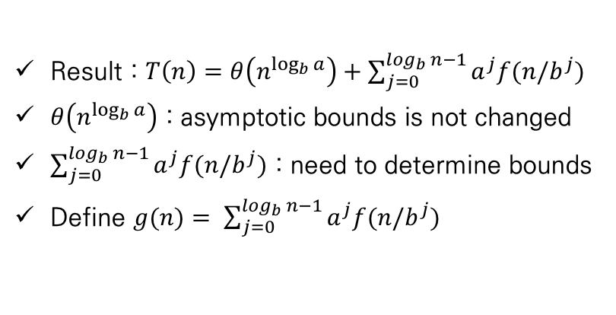
Divide-and-Conquer
Proof of the Master theorem
The proof for exact powers
Step 2 – determine bounds on result summation’s growth of step 1
Result : $T\left(n\right)=θ\left(n^{\log_{b}{a}}\right)+\sum_{j=0}^{\log_{b}{n}−1}{a^{j}f(n/b^{j})}$
$θ\left(n^{\log_{b}{a}}\right)$ : asymptotic bounds is not changed
$\sum_{j=0}^{\log_{b}{n}−1}{a^{j}f(n/b^{j})}$ : need to determine bounds
Define $g(n)= \sum_{j=0}^{\log_{b}{n}−1}{a^{j}f(n/b^{j})}$
Notes:
모든 Feature마다 이상치를 제거하게 되면 너무 많은 데이터 손실이 발생

Slide 8
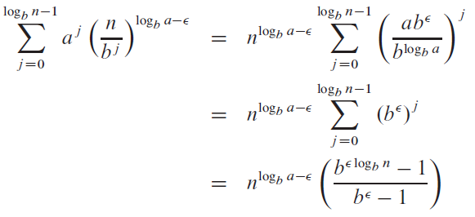
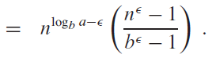
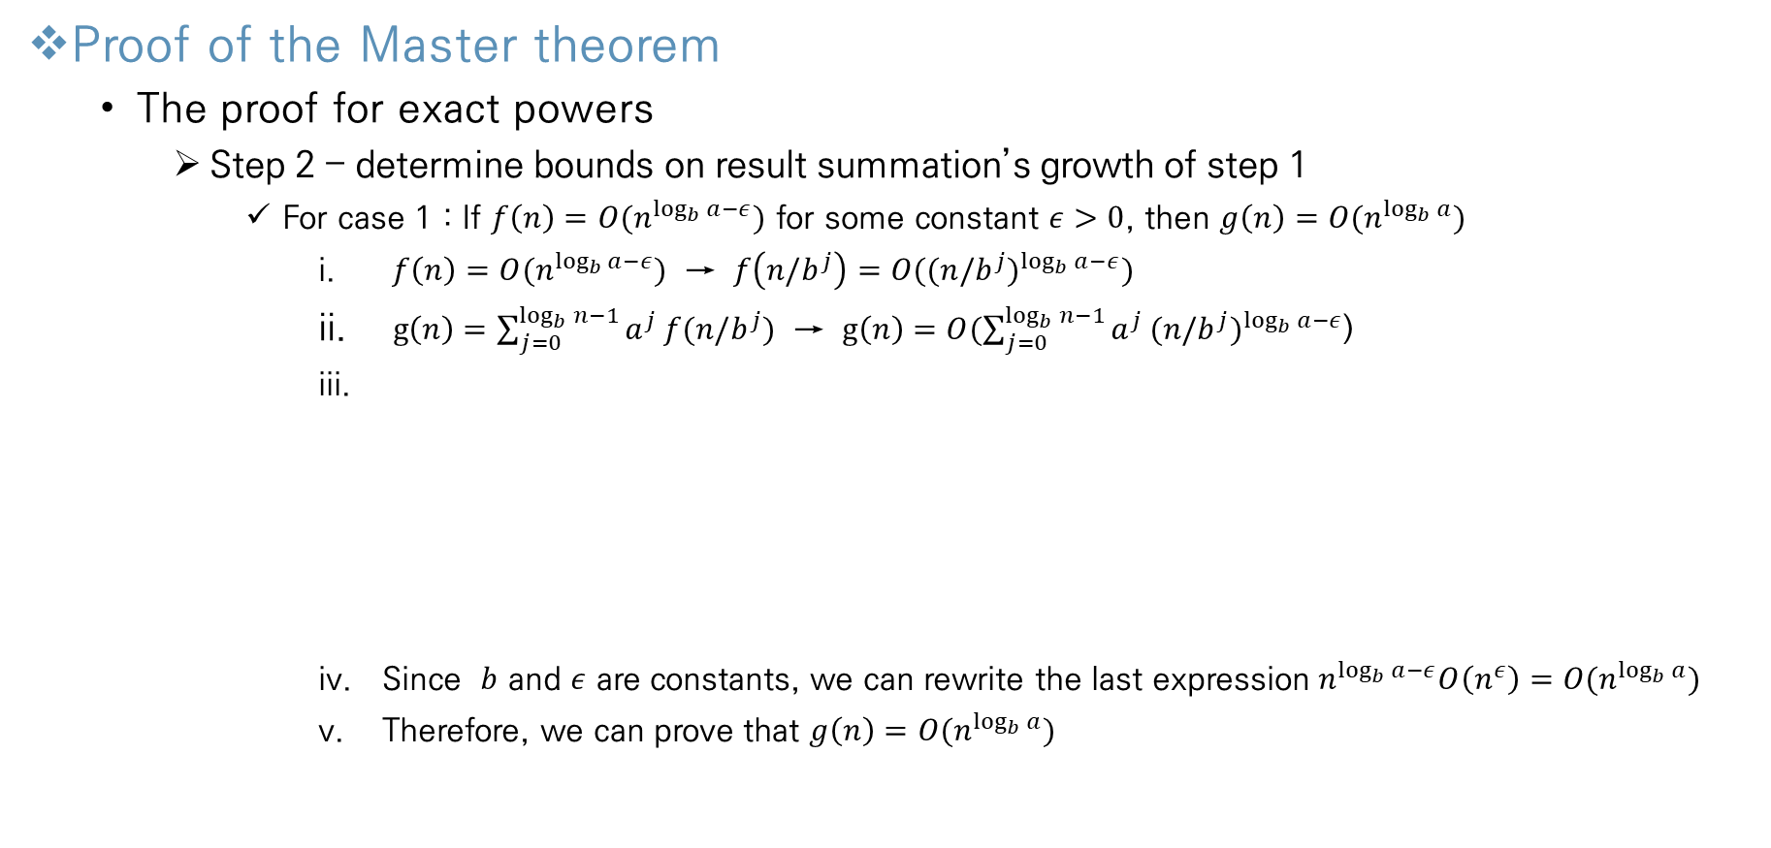
Divide-and-Conquer
Proof of the Master theorem
The proof for exact powers
Step 2 – determine bounds on result summation’s growth of step 1
For case 1 : If $f\left(n\right)=O(n^{\log_{b}{a}−ε})$ for some constant $ε>0$, then $g\left(n\right)=O(n^{\log_{b}{a}})$
$f\left(n\right)=O(n^{\log_{b}{a}−ε})$ → $f\left(n/b^{j}\right)=O(({n/b^{j})}^{\log_{b}{a}−ε})$
$g\left(n\right)=\sum_{j=0}^{\log_{b}{n}−1}{a^{j}}f(n/b^{j})$ → $g\left(n\right)=O(\sum_{j=0}^{\log_{b}{n}−1}{a^{j}}(n/b^{j})^{\log_{b}{a}−ε}$)
Since $b$ and $ε$ are constants, we can rewrite the last expression $n^{\log_{b}{a}−ε}O\left(n^{ε}\right)=O(n^{\log_{b}{a}})$
Therefore, we can prove that $g\left(n\right)=O(n^{\log_{b}{a}})$
Notes:
모든 Feature마다 이상치를 제거하게 되면 너무 많은 데이터 손실이 발생

Slide 9
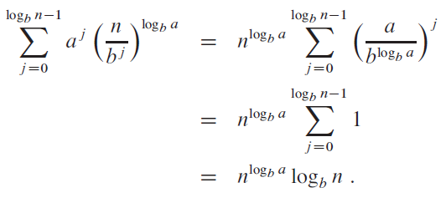

Divide-and-Conquer
Proof of the Master theorem
The proof for exact powers
Step 2 – determine bounds on result summation’s growth of step 1
For case 2 : If $f\left(n\right)=θ\left(n^{\log_{b}{a}}\right),$ then $g\left(n\right)=θ(n^{\log_{b}{a}}\lg{n})$
$f\left(n\right)=θ(n^{\log_{b}{a}})$ → $f\left(n/b^{j}\right)=θ(({n/b^{j})}^{\log_{b}{a}})$
$g\left(n\right)=\sum_{j=0}^{\log_{b}{n}−1}{a^{j}}f(n/b^{j})$ → $g\left(n\right)=θ(\sum_{j=0}^{\log_{b}{n}−1}{a^{j}}(n/b^{j})^{\log_{b}{a}}$)
Therefore, we can prove that $g\left(n\right)=θ\left(n^{\log_{b}{a}}\lg{n}\right)$
For case 3 : we can prove same method
Notes:
모든 Feature마다 이상치를 제거하게 되면 너무 많은 데이터 손실이 발생

Slide 10
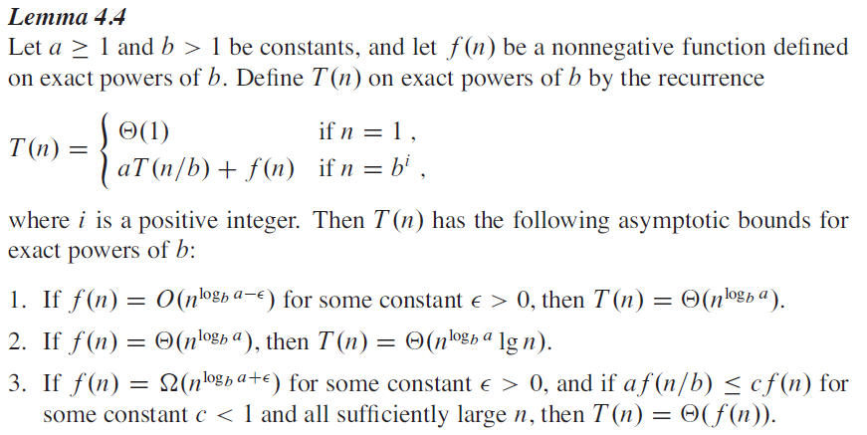
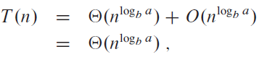
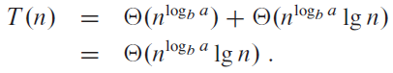
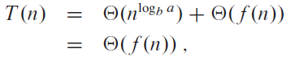
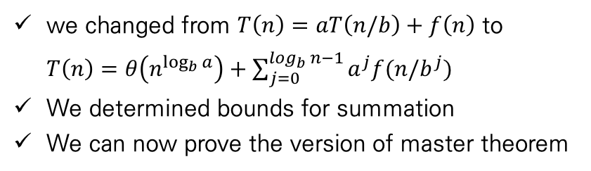
Divide-and-Conquer
Proof of the Master theorem
The proof for exact powers
Step 3 – combine step 1,2 to prove master theorem
we changed from $T\left(n\right)=aT\left(n/b\right)+f\left(n\right)$ to $T\left(n\right)=θ\left(n^{\log_{b}{a}}\right)+\sum_{j=0}^{\log_{b}{n}−1}{a^{j}f(n/b^{j})}$
We determined bounds for summation
We can now prove the version of master theorem
Case 1
Case 2
Case 3
Notes:
모든 Feature마다 이상치를 제거하게 되면 너무 많은 데이터 손실이 발생

Slide 11
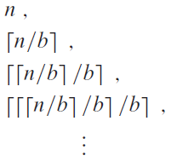
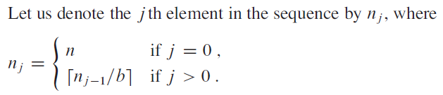
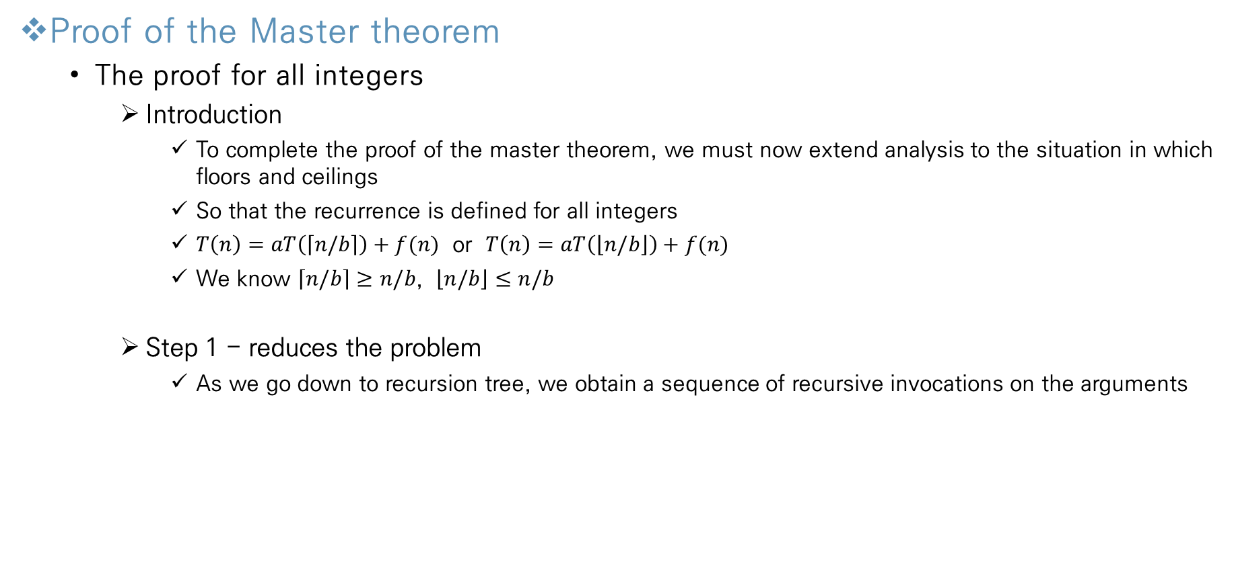
Divide-and-Conquer
Proof of the Master theorem
The proof for all integers
Introduction
To complete the proof of the master theorem, we must now extend analysis to the situation in which floors and ceilings
So that the recurrence is defined for all integers
$T\left(n\right)=aT\left(\left\lceil n/b\right\rceil \right)+f(n)$ or $T\left(n\right)=aT\left(\left\lfloor n/b\right\rfloor \right)+f(n)$
We know $\left\lceil n/b\right\rceil ≥n/b$, $\left\lfloor n/b\right\rfloor ≤n/b$
Step 1 - reduces the problem
As we go down to recursion tree, we obtain a sequence of recursive invocations on the arguments
Notes:
모든 Feature마다 이상치를 제거하게 되면 너무 많은 데이터 손실이 발생

Slide 12
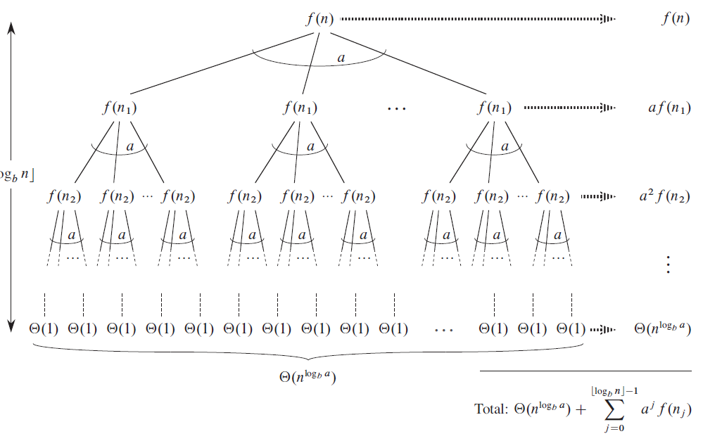
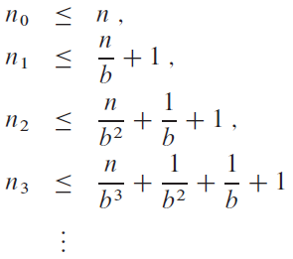
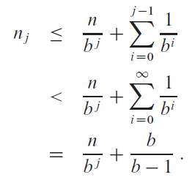
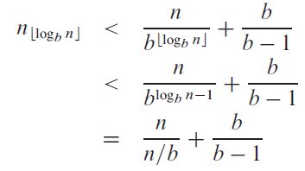
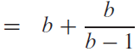
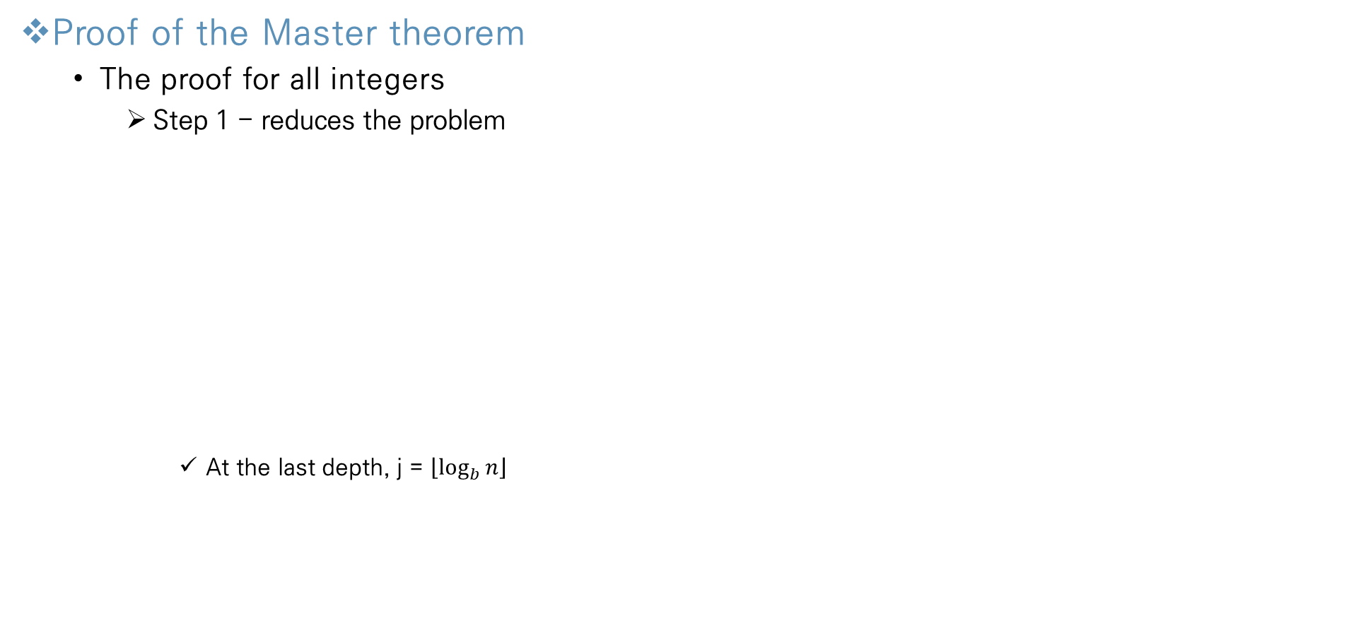
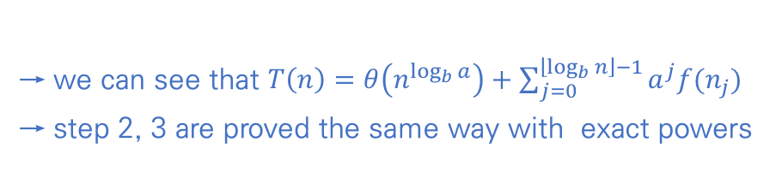
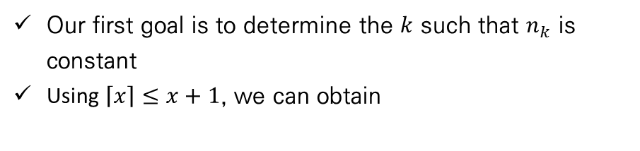
Divide-and-Conquer
Proof of the Master theorem
The proof for all integers
Step 1 - reduces the problem
At the last depth, j = $\left\lfloor \log_{b}{n}\right\rfloor$
Our first goal is to determine the $k$ such that $n_{k}$ is constant
Using $\left\lceil x\right\rceil ≤x+1$, we can obtain
Node size
of each depth
Bounds for
each depth
General form
→ we can see that $T\left(n\right)=θ\left(n^{\log_{b}{a}}\right)+\sum_{j=0}^{\left\lfloor \log_{b}{n}\right\rfloor −1}{a^{j}f(n_{j})}$
→ step 2, 3 are proved the same way with exact powers
Notes:
모든 Feature마다 이상치를 제거하게 되면 너무 많은 데이터 손실이 발생

Slide 13
Contents
Chapter.1 Foundations
Ç
The Role of Algorithms in Computing
Algorithms
Algorithms as a technology
Getting Started
Insertion sort
Analyzing algorithms
Designing algorithms
Growth of Functions
Asymptotic notation
Standard notations and common functions
Divide-and-Conquer
The maximum-subarray problem
Strassen’s algorithm for matrix multiplication
The substitution method for solving recurrences
The recursion-tree method for solving recurrences
The master method for solving recurrences
Proof of the master theorem
Probabilistic Analysis and Randomized Algorithms
The hiring problem
Indicator random variables
Randomized algorithms
Probabilistic analysis and further uses of indicator random variables
Notes:
모든 Feature마다 이상치를 제거하게 되면 너무 많은 데이터 손실이 발생

Slide 14

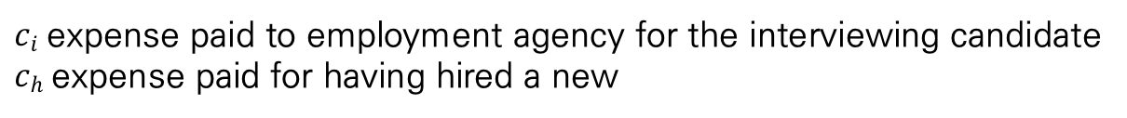

Probabilistic Analysis and Randomized Algorithms
The hiring problem
Definition of the hiring problem
$ci$expense paid to employment agency for the interviewing candidate
$ch$ expense paid for having hired a new
need to hire an employee
$$ci$$
interview a new candidate each day
hire the candidate if better qualified
$$ch$$
employment agency
candidate
Notes:
모든 Feature마다 이상치를 제거하게 되면 너무 많은 데이터 손실이 발생

Slide 15
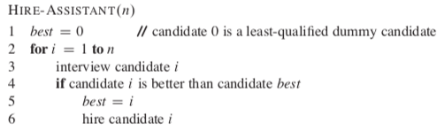
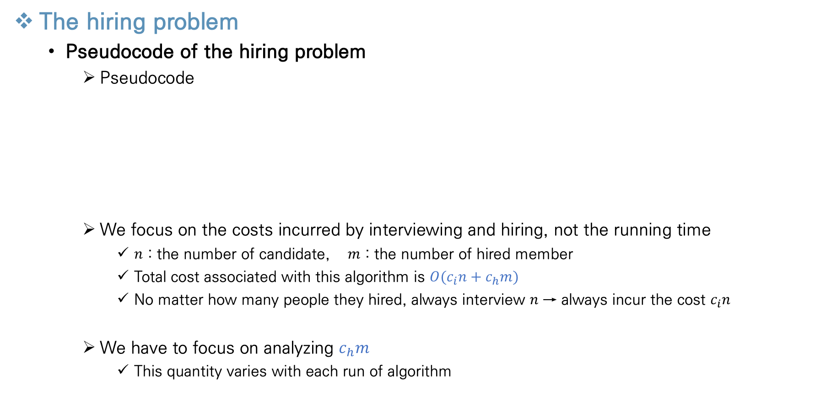
Probabilistic Analysis and Randomized Algorithms
The hiring problem
Pseudocode of the hiring problem
Pseudocode
We focus on the costs incurred by interviewing and hiring, not the running time
$n$ : the number of candidate, $m$ : the number of hired member
Total cost associated with this algorithm is $O(c_{i}n+c_{h}m)$
No matter how many people they hired, always interview $n$ → always incur the cost $c_{i}n$
We have to focus on analyzing $c_{h}m$
This quantity varies with each run of algorithm
Notes:
모든 Feature마다 이상치를 제거하게 되면 너무 많은 데이터 손실이 발생

Slide 16
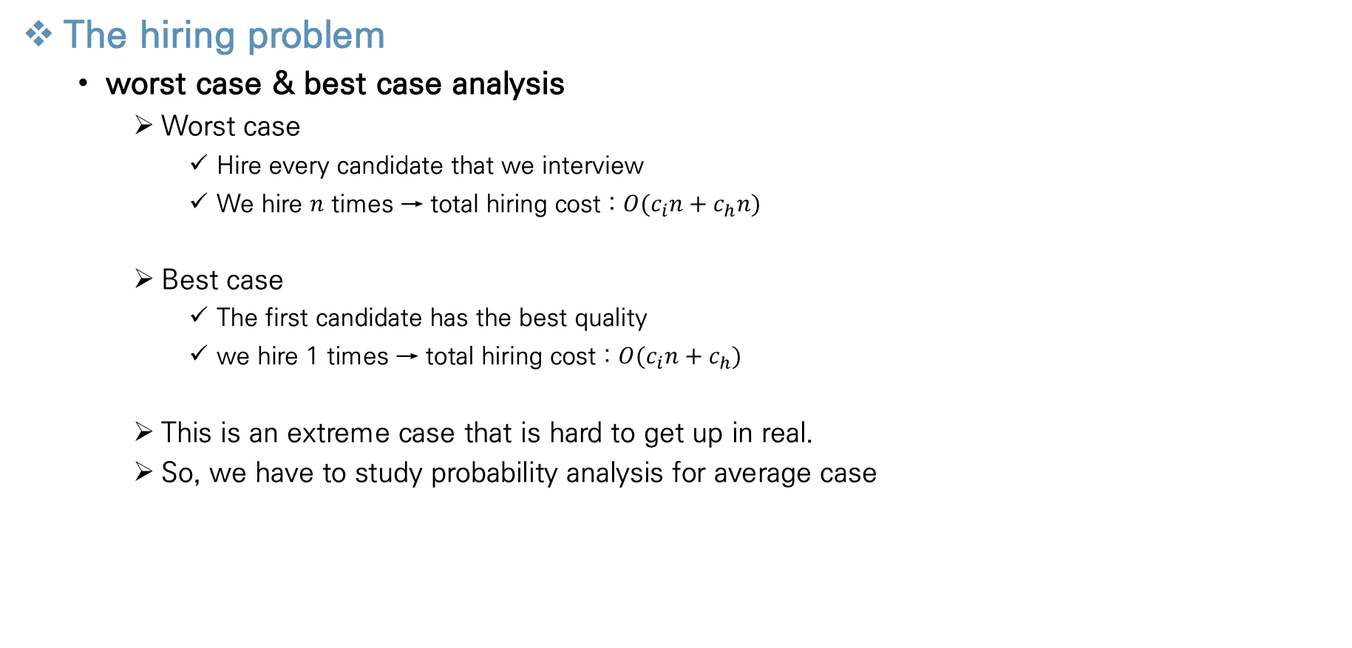
Probabilistic Analysis and Randomized Algorithms
The hiring problem
worst case & best case analysis
Worst case
Hire every candidate that we interview
We hire $n$ times → total hiring cost : $O(c_{i}n+c_{h}n)$
Best case
The first candidate has the best quality
we hire 1 times → total hiring cost : $O(c_{i}n+c_{h})$
This is an extreme case that is hard to get up in real.
So, we have to study probability analysis for average case
Notes:
모든 Feature마다 이상치를 제거하게 되면 너무 많은 데이터 손실이 발생

Slide 17
Probabilistic Analysis and Randomized Algorithms
The hiring problem
Probabilistic analysis
Probabilistic analysis is the use of probability in the analysis of problem
Commonly it is used to analyze the running time of an algorithm
Sometimes it is used to analyze other quantity (ex. Hiring problem)
We make assumptions about the distribution of inputs before computing average–case running time
We can average the running time over all possible inputs
We must be very careful in deciding on the distribution of inputs
Reasonable assumptions need to be made in order to apply probability analysis
Notes:
모든 Feature마다 이상치를 제거하게 되면 너무 많은 데이터 손실이 발생

Slide 18
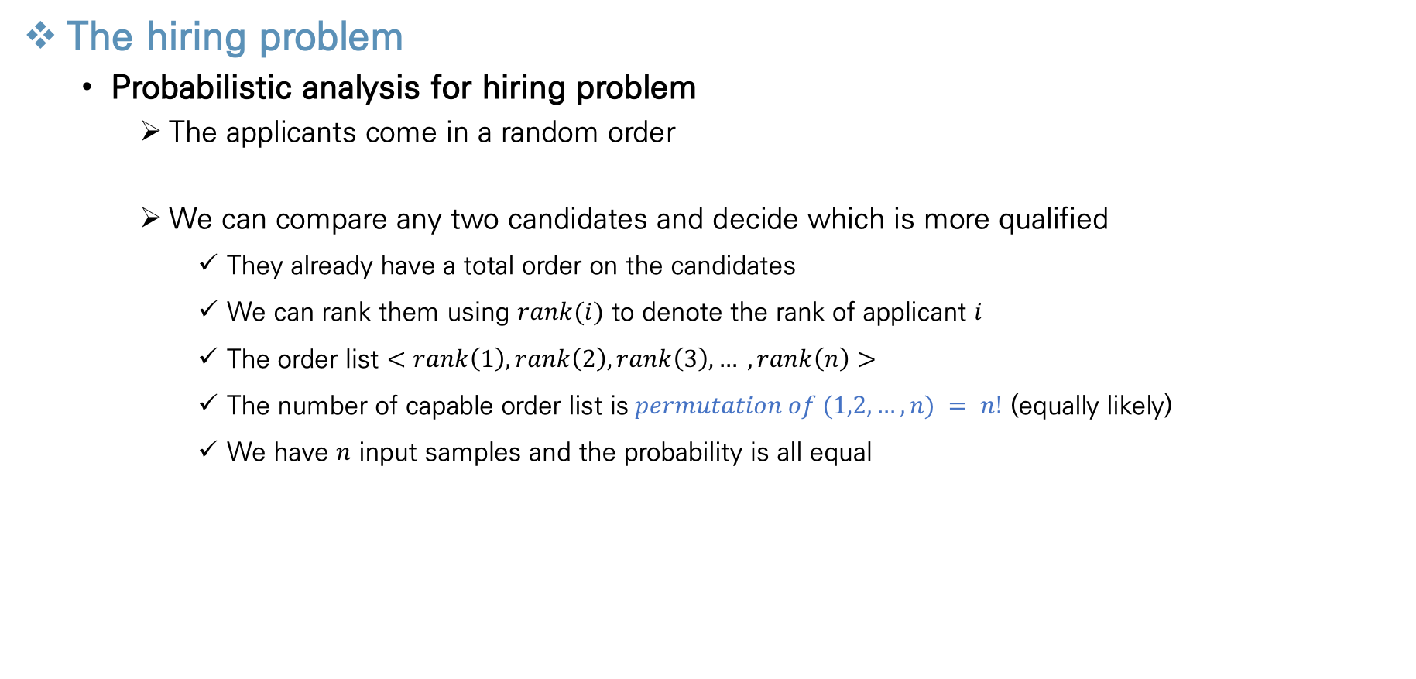
Probabilistic Analysis and Randomized Algorithms
The hiring problem
Probabilistic analysis for hiring problem
The applicants come in a random order
We can compare any two candidates and decide which is more qualified
They already have a total order on the candidates
We can rank them using $rank(i)$ to denote the rank of applicant $i$
The order list $<rank\left(1\right), rank\left(2\right), rank\left(3\right), … ,rank\left(n\right)>$
The number of capable order list is$permutation of (1,2,…,n) = n!$ (equally likely)
We have $n$ input samples and the probability is all equal
Notes:
모든 Feature마다 이상치를 제거하게 되면 너무 많은 데이터 손실이 발생

Slide 19
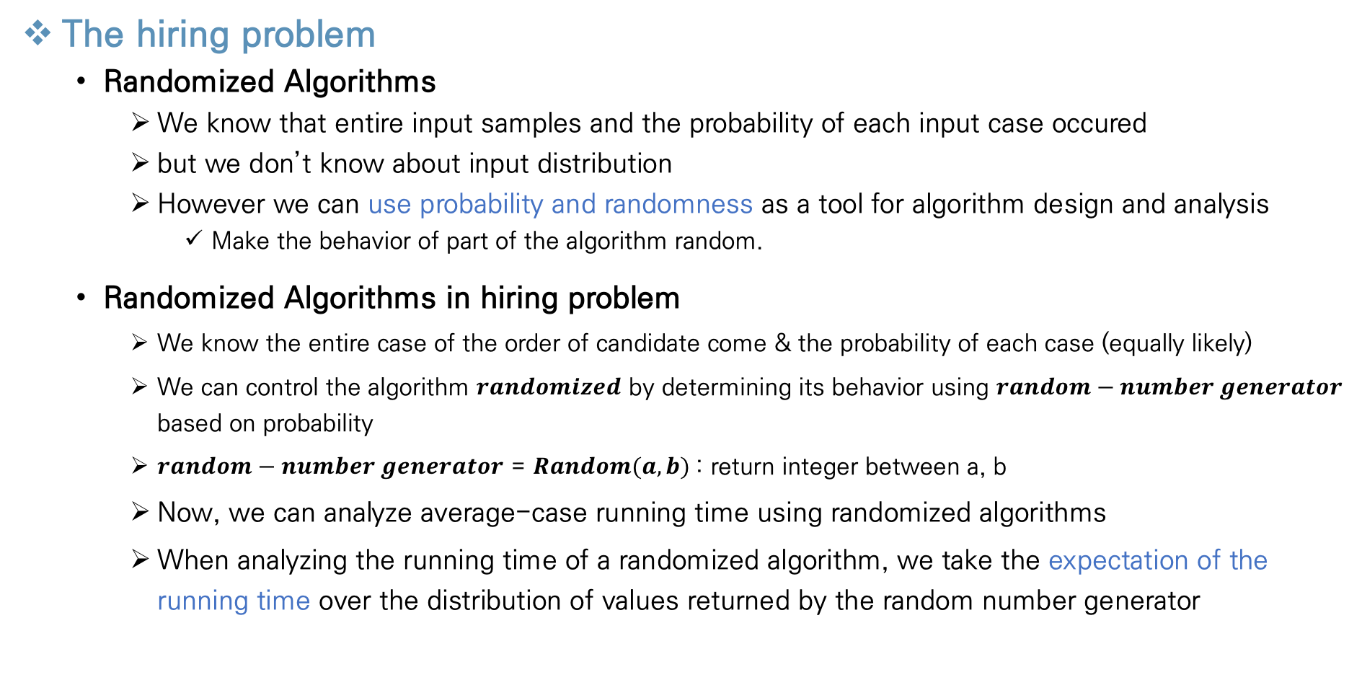
Probabilistic Analysis and Randomized Algorithms
The hiring problem
Randomized Algorithms
We know that entire input samples and the probability of each input case occured
but we don’t know about input distribution
However we can use probability and randomness as a tool for algorithm design and analysis
Make the behavior of part of the algorithm random.
Randomized Algorithms in hiring problem
We know the entire case of the order of candidate come & the probability of each case (equally likely)
We can control the algorithm $randomized$ by determining its behavior using $random−number generator$ based on probability
$random−number generator$ = $Random(a, b)$: return integer between a, b
Now, we can analyze average-case running time using randomized algorithms
When analyzing the running time of a randomized algorithm, we take the expectation of the running time over the distribution of values returned by the random number generator
Notes:
모든 Feature마다 이상치를 제거하게 되면 너무 많은 데이터 손실이 발생

Slide 20
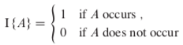
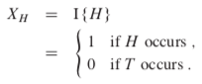
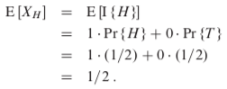
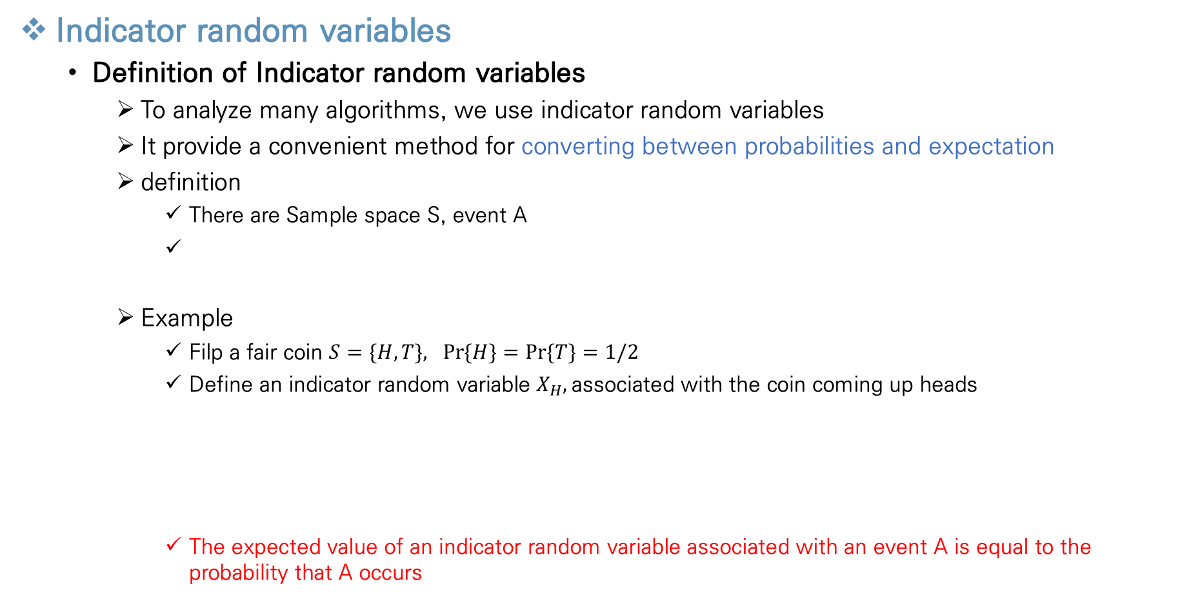
Probabilistic Analysis and Randomized Algorithms
Indicator random variables
Definition of Indicator random variables
To analyze many algorithms, we use indicator random variables
It provide a convenient method for converting between probabilities and expectation
definition
There are Sample space S, event A
Example
Filp a fair coin $S=\{H, T\}, Pr⁡\{H\}=Pr⁡\{T\}=1/2$
Define an indicator random variable $X_{H},$associated with the coin coming up heads
The expected value of an indicator random variable associated with an event A is equal to the probability that A occurs
Expected value
Notes:
모든 Feature마다 이상치를 제거하게 되면 너무 많은 데이터 손실이 발생

Slide 21
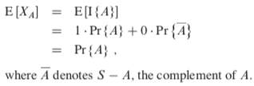
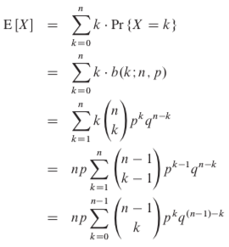
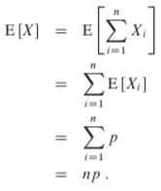
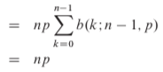
Probabilistic Analysis and Randomized Algorithms
Indicator random variables
Definition of Indicator random variables
Prove it
Indicator random variables are useful for analyzing situations in which we perform repeated random trials
Example – Calculate the expected value for the number of times the head comes out when n coins are thrown
Calculate much more easily
Notes:
모든 Feature마다 이상치를 제거하게 되면 너무 많은 데이터 손실이 발생

Slide 22
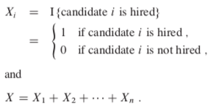
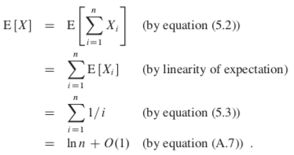
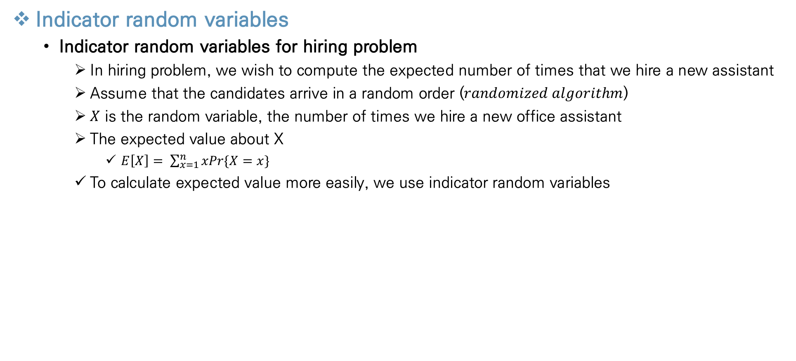
Probabilistic Analysis and Randomized Algorithms
Indicator random variables
Indicator random variables for hiring problem
In hiring problem, we wish to compute the expected number of times that we hire a new assistant
Assume that the candidates arrive in a random order ($randomized algorithm$)
$X$ is the random variable, the number of times we hire a new office assistant
The expected value about X
$E\left[X\right]= \sum_{x=1}^{n}{xPr\{X=x\}}$
To calculate expected value more easily, we use indicator random variables
Notes:
모든 Feature마다 이상치를 제거하게 되면 너무 많은 데이터 손실이 발생

Slide 23
Thank You!

